Slide 1
Customer Churn Prediction in Metro Cash and Carry, India
Anurag Pandey
Harsha Vardhan Vemulapati
Rohit Sarkar
Rony Chacko
Shantanu Kulkarni

Slide 2
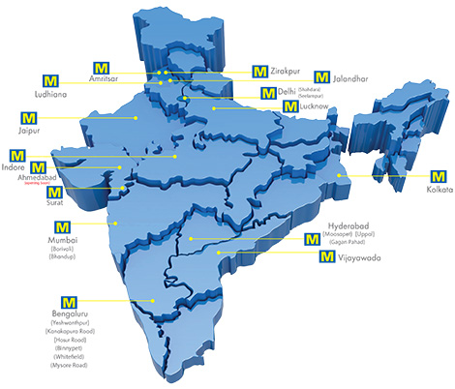
Overview –
Company Profile
Customer Profile
METRO Cash and Carry in represented in over 25 countries and having a headquarter in Dusseldorf, Germany
METRO Cash & Carry pioneered the business-to-business wholesale concept
Every day at METRO serves business customers with approx. 50,000 food and non-food products, available under one roof at wholesale prices
Commenced Indian operations in 2003
23 operational wholesale centers in India. Each center typically stocks over 15000 SKUs
Core customer include - Small retailers & “kirana” outlets
-Hotels, Restaurants & Caterers
-Corporates & SME’s
METRO’s unique business model is defined by its registered wholesale customer base
Products are available with options of bulk packs, refill packs, or multiple-packs for the convenience of professional customers
It aimed at enabling small retailers to stock themselves, which significantly reduces the procurement and inventory cost.

Slide 3

Metro India Wants to Identify Key drivers of Customer Churn
A better framework to identify leading indicators which are contributing to customer churn is required
Metro Unique business model is defined by its registered wholesale customer base
Metro India has realized that 32.2% of registered customer churn in a year
Metro wants to understand the combined effect of transactional metrics on customer churn and also needs recommendations on key drivers to act on
Metro India recognized key drivers which are leading customer churn
It can prioritize customer engagement by considering customer purchase rate, promotional sales, newly acquired customer behavior etc
A comprehensive plan including promotion, assortment, bundling and coupons etc has been prepared to minimize customer churn
Impact of Promo vs Non-promo, Discounts on customer churn
Trip behavior (Stock up vs seasonal vs department destination)
Food vs Non Food visit behavior
Visit Pattern: Repeat rate, Recency, Trail rate for New Customers etc

Slide 4
Dataset Description
Our project uses first-hand data received from a METRO employee. Metro uses this sample live dataset to test new applicants who want to join the analytics wing of the organization.
How many observations in the dataset | 10000
How many binary variables | 4
How many nominal variables | 1
How many interval variables | 91
What is the outcome / target variable | customer churn or not
What is the level of the target variable (nominal, binary or interval) | binary
If binary or nominal: What percentage of the variables belong to each class. | 32.04% - churned customer 67.96% - consistent customer
If interval: What is the mean value of the target variable? | NA
Before doing any further processing, what is your prediction of the target variable? | Approximately 7 out of 10 customers will continue shopping in Metro Cash & Carry
Apriori Statistics
Data Partition
60% Training Data
20% Validation Data
20% Test Data

Slide 5
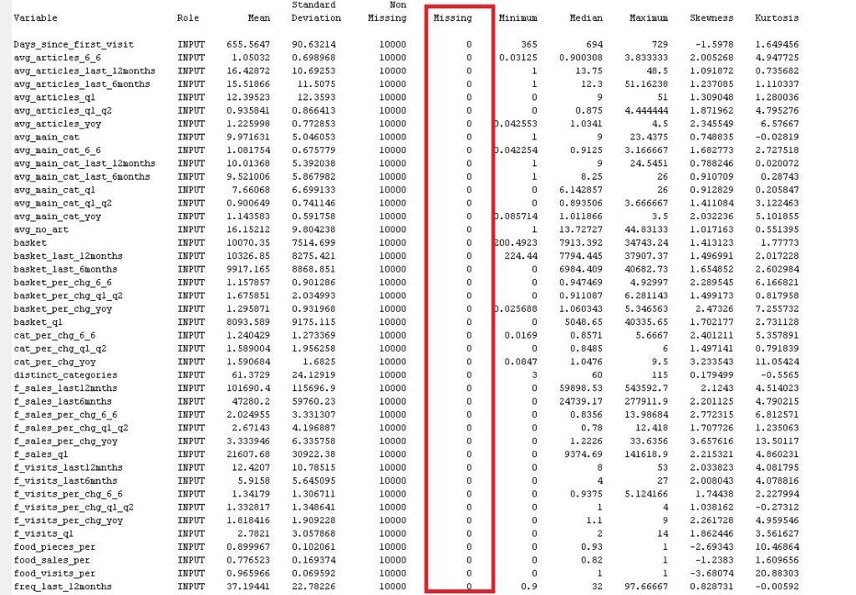
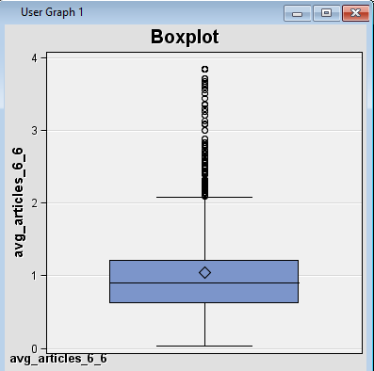
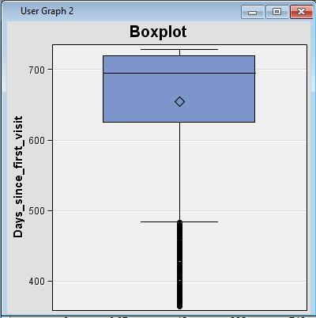
Missing value treatment
Outlier Detection
Outliers were treated by capping the variables
Capping on the upper limit was done by replacing the variables with the 99 percentile value and on the lower limit with the 1 percentile value of the distribution.
Notes:
No missing values in the dataset

Slide 6
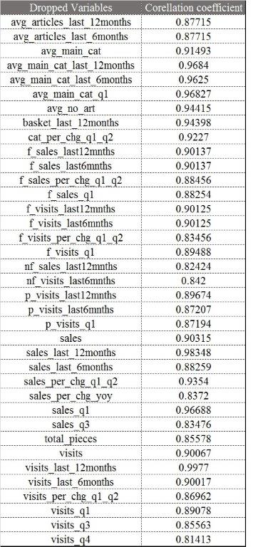
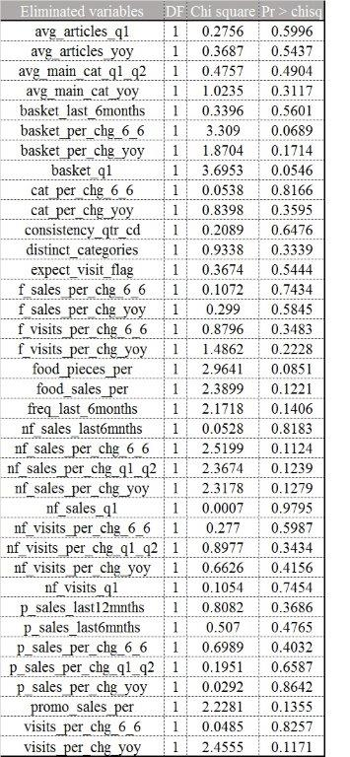
Multicollinearity Check
Variable Selection Method

Slide 7
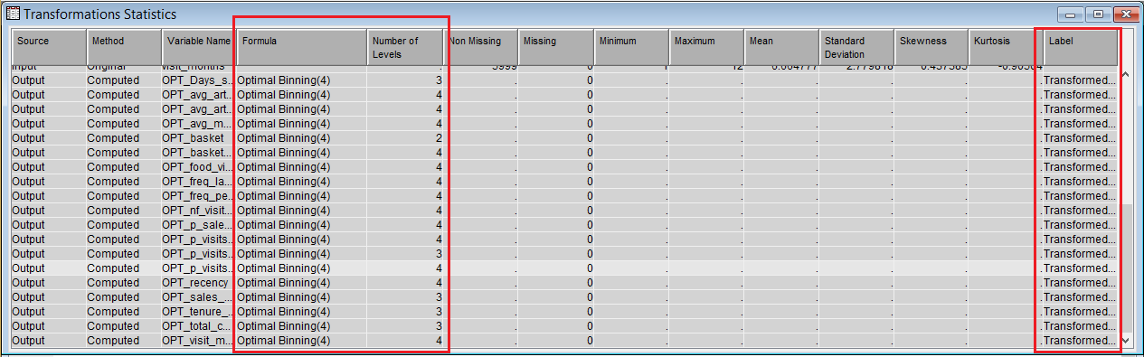
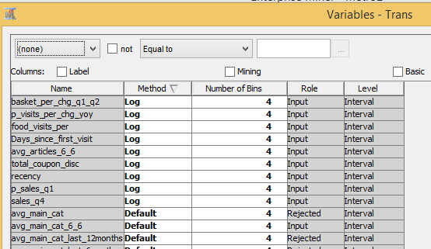
1st try of Binning – Optimal Binning
Log Transform

Slide 8
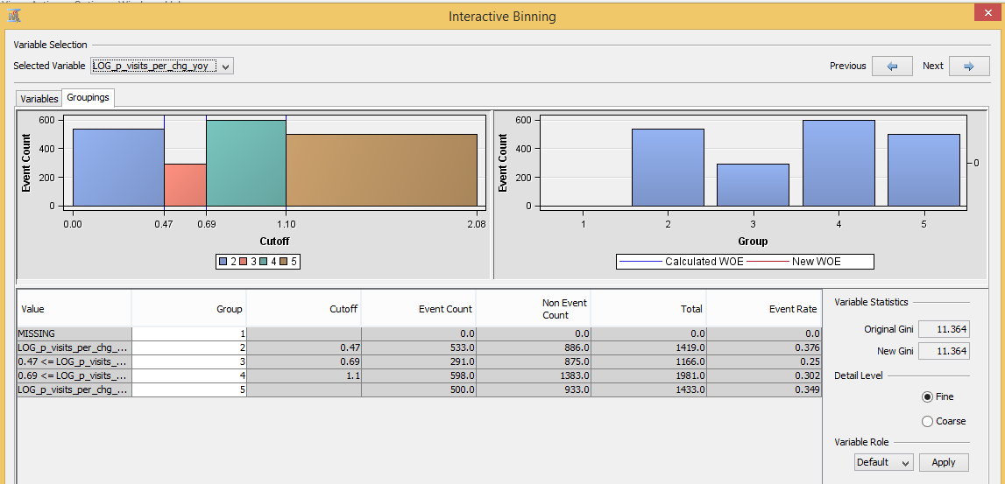
2nd try of Binning – Interactive Binning

Slide 9
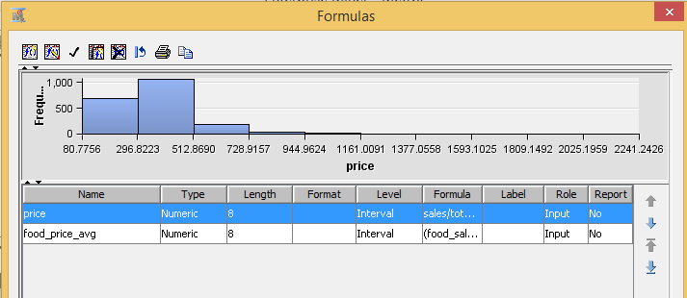
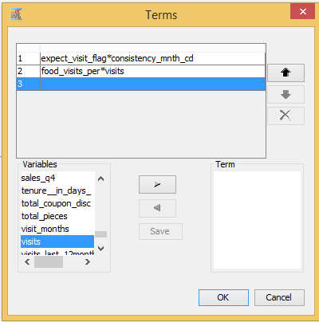
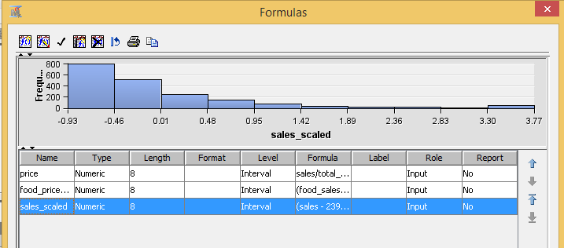
Feature Creation
Interaction Variable
Variable Standardization

Slide 10
Data enjoys diverse array of customers, therefore absolute values of some variables is highly skewed
Rescaling using variable standardization has been tried to improve significance of such variables
Correlated independent variables have been eliminated iteratively to achieve unbiased mutually exhaustive explanatory variables
Backward elimination provides final list of significant variables
Variable Selection
Feature Creation
Data Transformation
To consider other psychographic variable like price point preferences etc new feature has been considered
Interaction variable has been considered to capture chemistry between explanatory variable
Different cut-off values iteratively have been tried out to create optimal bins which can produce better classification results
Log transformation used to provide symmetric distribution in case of skewness

Slide 11
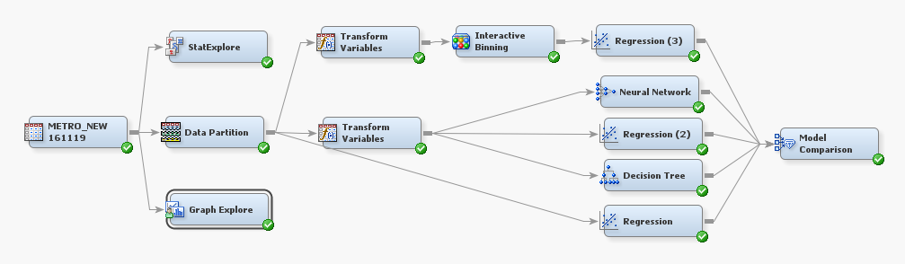
MODEL COMPARISON
LOGISTIC REGRESSION WITH OPTIMAL BINNING
LOGISTIC REGRESSION WITH INTERACTIVE BINNING
LOGISTIC REGRESSION BEFORE VARIABLE TRANSFORMATION
NEURAL NETWORK
DECISION TREE

Slide 12
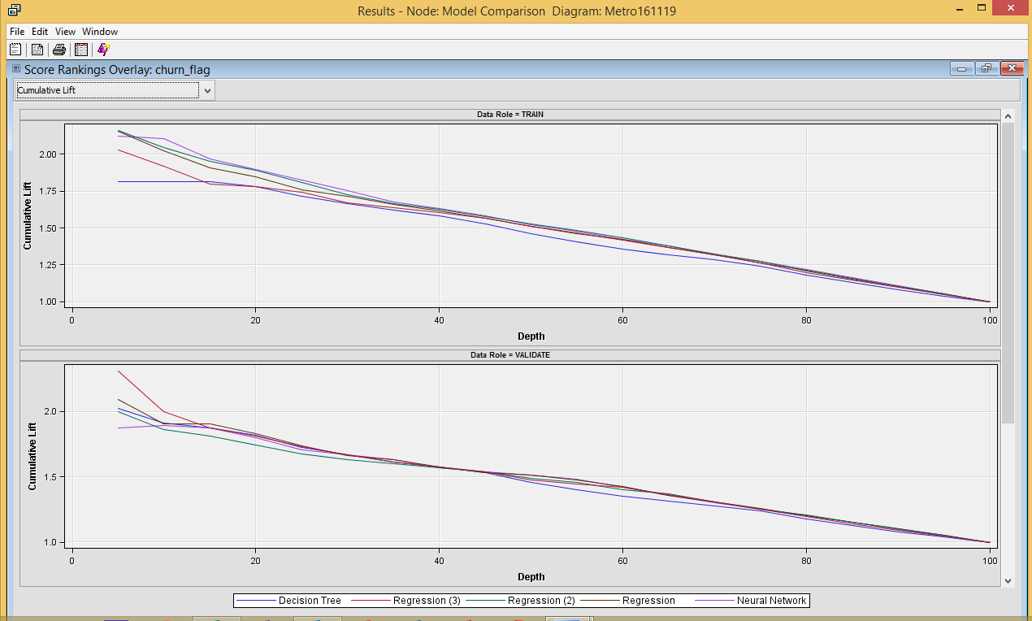
Cumulative Lift curve of the Models

Slide 13
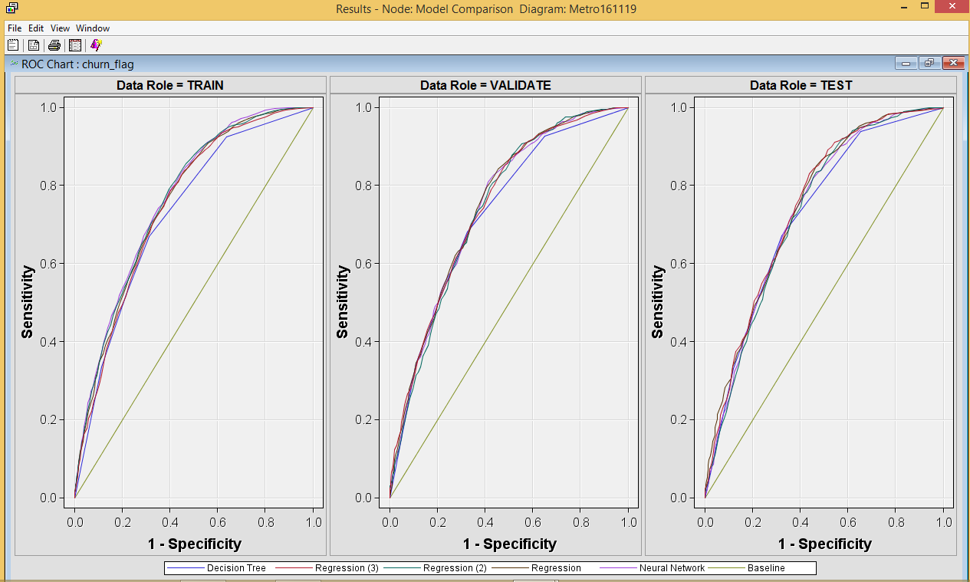
ROC curve of the Models

Slide 14
After Interactive Binning
After Optimal Binning
Before Variable Transformation
Conclusion
As per the validation misclassification rate, the Decision Tree proved to be the best among all the models, followed closely behind by Regression(3).
As per the training misclassification rate, Neural Network model performed better than the rest.
BUT as our main objective is to determine the key drivers that are responsible for customer churn, we selected the Regression(3) model as the best model for our project
Recommendation

Slide 15
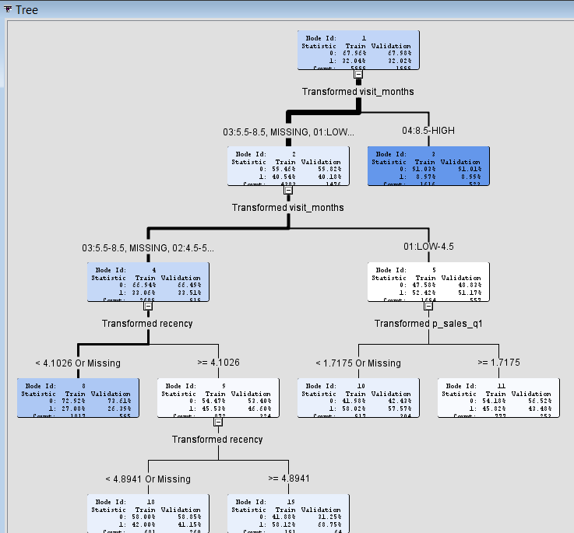
DECISION TREE
MODEL COMPARISON

Slide 16
CONFUSION MATRIX
MODEL COMPARISON
NEURAL NETWORK
 |  | Training Model Prediction
 |  | Churn | Retain
Actual | Churn | 769 | 1153
 | Retain | 509 | 3568
 |  | Validation Model Prediction
 |  | Churn | Retain
Actual | Churn | 240 | 400
 | Retain | 185 | 1174
DECISION TREE
 |  | Training Model Prediction
 |  | Churn | Retain
Actual | Churn | 643 | 1279
 | Retain | 465 | 3612
 |  | Validation Model Prediction
 |  | Churn | Retain
Actual | Churn | 219 | 421
 | Retain | 149 | 1210
LOGISTIC REGRESSION (AFTER INTERACTIVE BINNING)
 |  | Training Model Prediction
 |  | Churn | Retain
Actual | Churn | 728 | 1194
 | Retain | 550 | 3527
 |  | Validation Model Prediction
 |  | Churn | Retain
Actual | Churn | 240 | 400
 | Retain | 175 | 1184

Slide 17
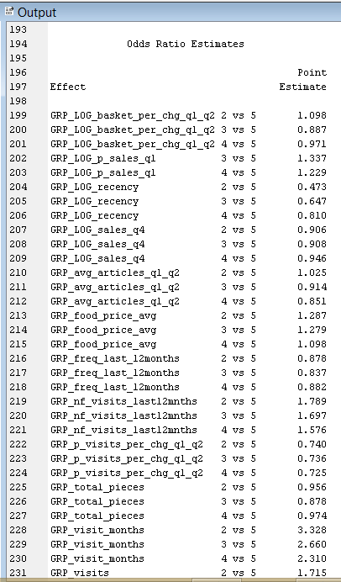
MODEL COMPARISON
LOGISTIC REGRESSION (AFTER INTERACTIVE BINNING)

Slide 18
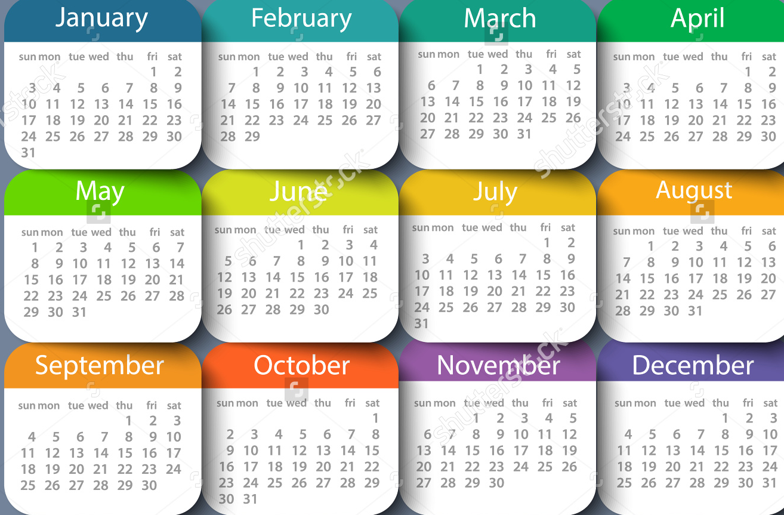

Key Drivers
Months visited/year
Food spend/year
< 9 ➔ 130%
< 4 ➔ 230%
< Rs. 55K ➔ 30%

Slide 19


Key Drivers
Non-food visits/year
Total Visits/year
< 8 ➔ 58%
< 1/3 ➔ 72%
< ½ ➔40%

Slide 20

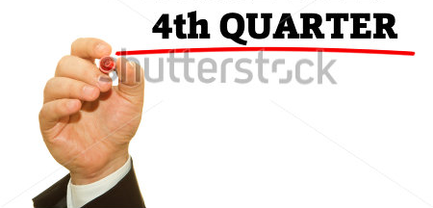
Key Drivers
Q1 patterns
Q4 patterns
Promo purchases < Rs 800 = 33%
Q1 to Q2 visit % ⬆ = Retention 25%
Q1 to Q2 #articles ⬆= Retention 33%
Recency (10 days) = Retention 50% After 2 months➔ 30% less odds
Visits ≥ 1 = Retention 25% ⬆

Slide 21
Action Plan
Months visited/year
Time limited promos
To increase repeat visits
New Customers/ Non food visits/Food visits
Provide food promos
Provide non-food promos
Q1 actions
Promos Q1(food) > Rs 4000
Q2(#articles) ⬆
Q4 actions
Promos Q4(visits) ≥ 1

